Slide 1



IILM UNIVERSITY
C++ Programming Internship
#include <iostream> // Practical Software Development at CodSoft
Student Name Kumar Jaipushp
Organization Name CodSoft
Enrollment Number 25SCS1003001283
Program & Semester B.Tech CSE — 3rd Semester

Slide 2

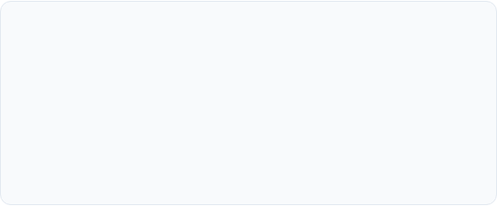
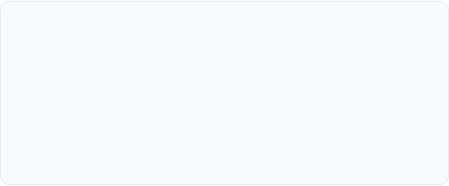
Executive Summary
Internship Purpose
Key Highlights
During my 3rd semester B.Tech CSE internship at CodSoft, I focused on mastering C++ programming concepts, Object-Oriented Software Design, and implementing practical software applications through task-driven projects.
Designed and deployed multiple C++ applications including algorithmic games, mathematical utility engines, and console management systems while adhering to memory optimization and clean code principles.

Slide 3
About Organization
CodSoft Overview
CodSoft is a vibrant IT services and software development platform dedicated to offering practical, industry-aligned virtual internships and mentorship in cutting-edge technologies.
The program emphasizes project-based skill acquisition, algorithmic efficiency, hands-on code development, and real-world problem-solving methodologies.

Slide 4
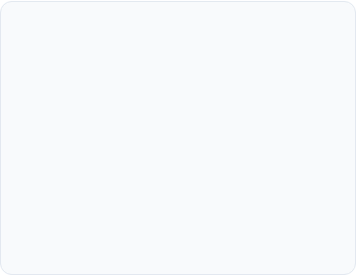
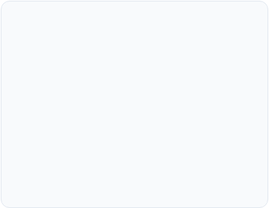
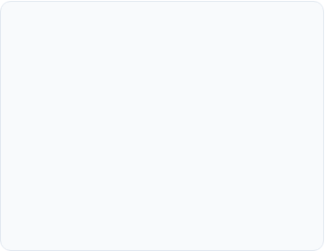



Internship Objectives
Core Concepts
OOP Principles
Problem Solving
Strengthen understanding of fundamental C++ syntax, pointers, dynamic memory allocation, and control flows.
Implement Object-Oriented Programming (Encapsulation, Inheritance, Polymorphism, Abstraction) in practical projects.
Develop modular logic, handle edge cases gracefully, and optimize code efficiency using C++ Standard Template Library (STL).

Slide 5
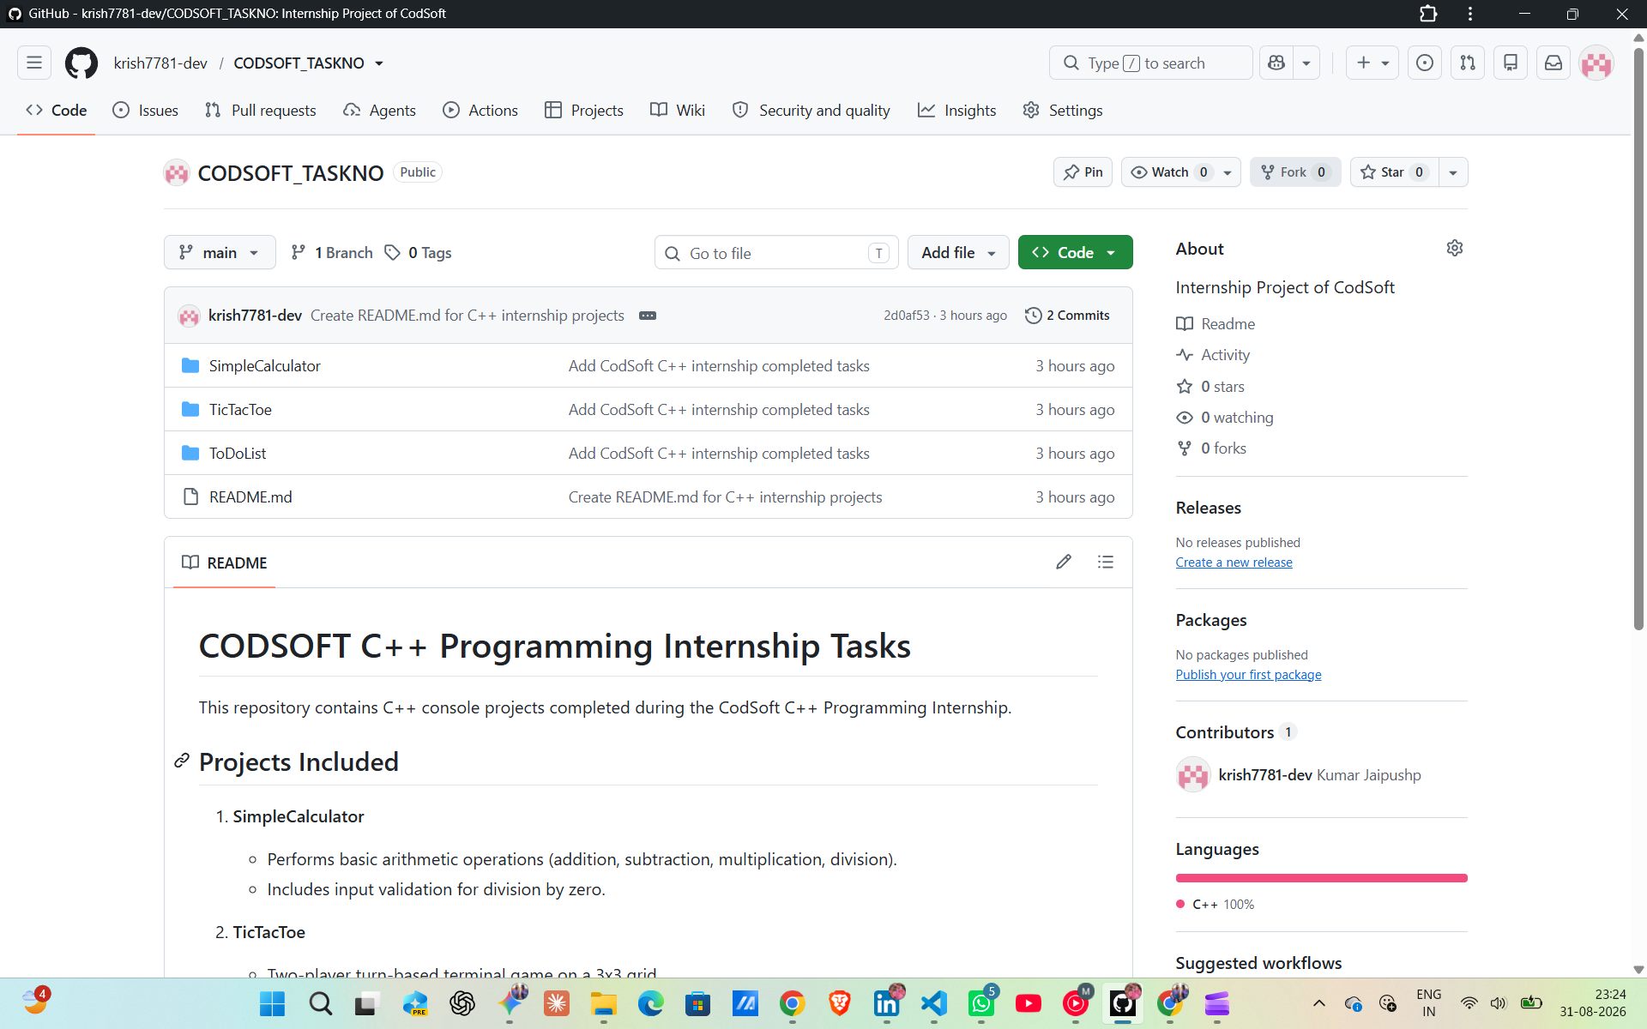
Key Projects Completed
Simple Calculator: Performs fundamental arithmetic operations using functional modules and validation.
Tic-Tac-Toe Game: Multi-player interactive console game incorporating 2D array matrix state checks.
To-Do List Manager: Console-based task tracking application supporting dynamic addition, status updating, and deletion of user tasks.

Slide 6
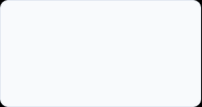
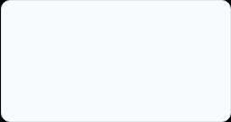
Internship Roadmap
Week 1
Week 2
Week 3
Week 4
Environment setup (GCC/MinGW, VS Code), C++ basics, syntax, & logic flow.
Object-Oriented Design, Classes, Constructors, & Method Overloading.
Data Structures, STL vectors/maps, Pointers & Memory Management.
Project integration, Dynamic Task Tracking, Debugging, Code documentation & Review.

Slide 7
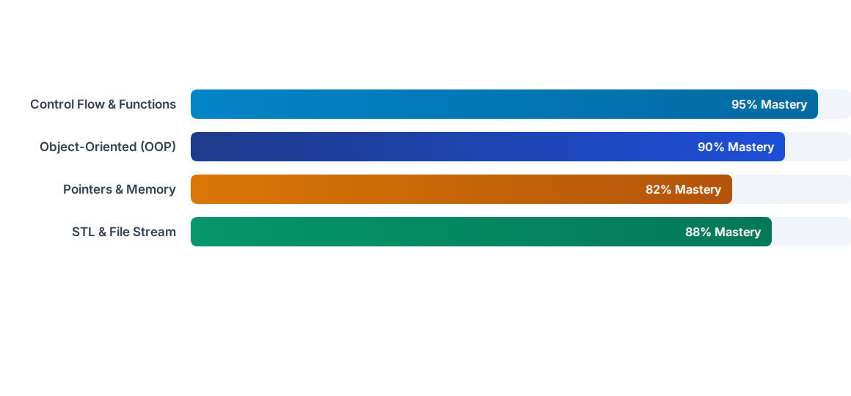
C++ Skill Distribution
Hands-on application development at CodSoft resulted in balanced technical growth across foundational and advanced C++ programming constructs.

Slide 8

Quantifiable Outcomes
100%
Software Quality Highlights
Successfully submitted all assigned C++ tasks within scheduled sprint deadlines with zero runtime syntax errors.
Employed robust exception handling and input sanitization to ensure 100% stability across custom test scenarios.
Task Completion Rate

Slide 9
Core Competencies Gained
Modern C++ Standards: Gained proficiency in modern C++ features including auto, lambda expressions, and smart pointers.
Debugging & Diagnostics: Utilized GDB and IDE diagnostic toolsets to track memory leaks and stack overflow issues.
Version Control: Maintained structured Git repositories with descriptive commit messages and branch management.
Code Documentation: Documented algorithms clearly using inline comments and standardized Markdown Readme files.

Slide 10
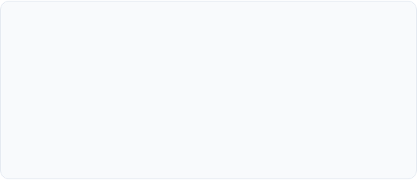
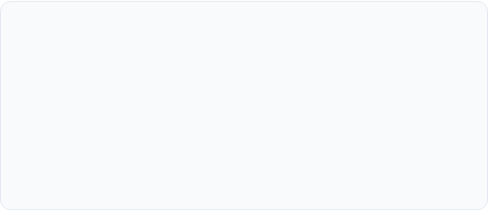
Challenges & Solutions
Pointers & Memory Leaks
Input Validation & Buffers
Challenge: Managing dynamic memory allocation using raw pointers resulted in dangling references during early testing.
Challenge: Infinite loops occurred when non-numeric data was inputted into numeric console fields.
Solution: Adopted RAII design patterns and smart pointers (std::unique_ptr) to automate memory cleanup.
Solution: Integrated cin.fail() checks and cin.ignore() stream buffer clear functions.

Slide 11



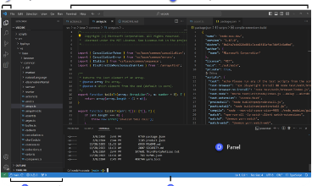

Future Learning Path
1. Advanced DSA
2. GUI Development
3. System Programming
Mastering complex graphs, dynamic programming, and tree traversals in C++.
Transitioning from console apps to desktop GUIs using the Qt C++ framework.
Exploring multi-threading, concurrency, and low-level system optimization.

Slide 12
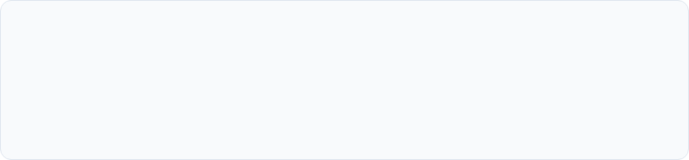
Thank You!
Questions & Discussion
Acknowledgements
Special thanks to my mentors at CodSoft for providing this valuable opportunity, and to the faculty members of the CSE Department at IILM University for their constant support during my 3rd semester internship.

Slide 13






Image Sources
https://f2.leadsquaredcdn.com/t/iilmuniversity/content/common/images/landingpages/circular%20logo-01.png
Source: admissions.iilm.edu
https://cdn-ilehile.nitrocdn.com/rvtTEKnNlfWfxEHgVdBZMuGGdqGuuvbT/assets/images/optimized/rev-5ac25bd/www.religroupinc.com/wp-content/uploads/2026/06/engineers-collaborating-in-office.jpg
Source: www.religroupinc.com
https://i.ytimg.com/vi/t7bxv0FCQbQ/maxresdefault.jpg
Source: www.youtube.com
https://external-preview.redd.it/introducing-dataviz-a-data-structure-visualization-library-v0-5fcRfLSI1VdWvDjHMjjnyzXiyXFXvX5aov8j8s-R--s.jpg?width=640&crop=smart&auto=webp&s=0de0b6a37caa07076831b55565b2ab93c92b6a44
Source: www.reddit.com
https://code.visualstudio.com/assets/docs/editing/userinterface/hero.png
Source: code.visualstudio.com
https://www.serverbasket.com/wp-content/uploads/2021/02/High-Performance-Computing-Server.png
Source: www.serverbasket.com

